Slide 1
SUDAKSHA EDUCATION PVT LTD
Microservices with Python
Course Content

Slide 2
Table of Content
Introduction to Microservices
Setting up the Python Environment
Building your First Microservice
Containerizing Microservices
Service Communication
Microservice Deployment
Security and Best Practices

Slide 3



Software Architecture Evolution
With Monolithic, tightly coupled applications, all changes must be pushed at once, making continuous deployment impossible.
Traditional SOA allows you to make changes to individual pieces. But each piece must be carefully altered to fit into the overall design.
With a microservices architecture, developers create, maintain, and improve new services independently, linking info through a share data API.

Slide 4
What is Microservice Architecture
A microservice architecture is an architectural pattern that arranges an application as a collection of loosely coupled, fine-grained services, communicating through lightweight protocols.
One of its goals is to enable teams to develop and deploy their services independently.
These services interact through well-defined APIs and are loosely coupled, allowing them to be developed, deployed, and scaled independently.
Microservice Architecture involves breaking an application into small, independent services with their own logic and data storage, each deployable and scalable independently. It emphasizes loose coupling and flexibility, allowing services to be developed and managed separately.

Slide 5
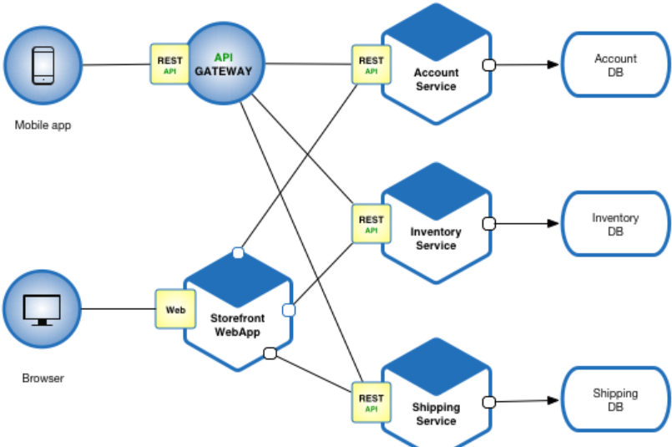
Example Microservice Architecture

Slide 6
Key Characteristics
Independent Deployment: Each microservice can be developed, deployed, and scaled independently.
Single Responsibility: Each service is responsible for a specific business function, promoting a modular approach.
Decentralized Data Management: Each microservice manages its own database, allowing for data to be organized around business capabilities.
Technology Diversity: Different microservices can be built using different programming languages, frameworks, or databases best suited to their function.

Slide 7
Monolithic vs Microservices
Monolithic Architecture
Structure: Single, unified codebase.
Deployment: Deployed as a single unit.
Scalability: Entire application must be scaled together.
Flexibility: Harder to adopt new technologies; tightly coupled components.
Resilience: Failure in one module can affect the entire system.
Microservices Architecture
Structure: Composed of multiple small, independent services.
Deployment: Services are deployed independently.
Scalability: Each service can be scaled independently.
Flexibility: Easier to integrate new technologies; loosely coupled components.
Resilience: Failure in one service doesn’t necessarily impact others.

Slide 8
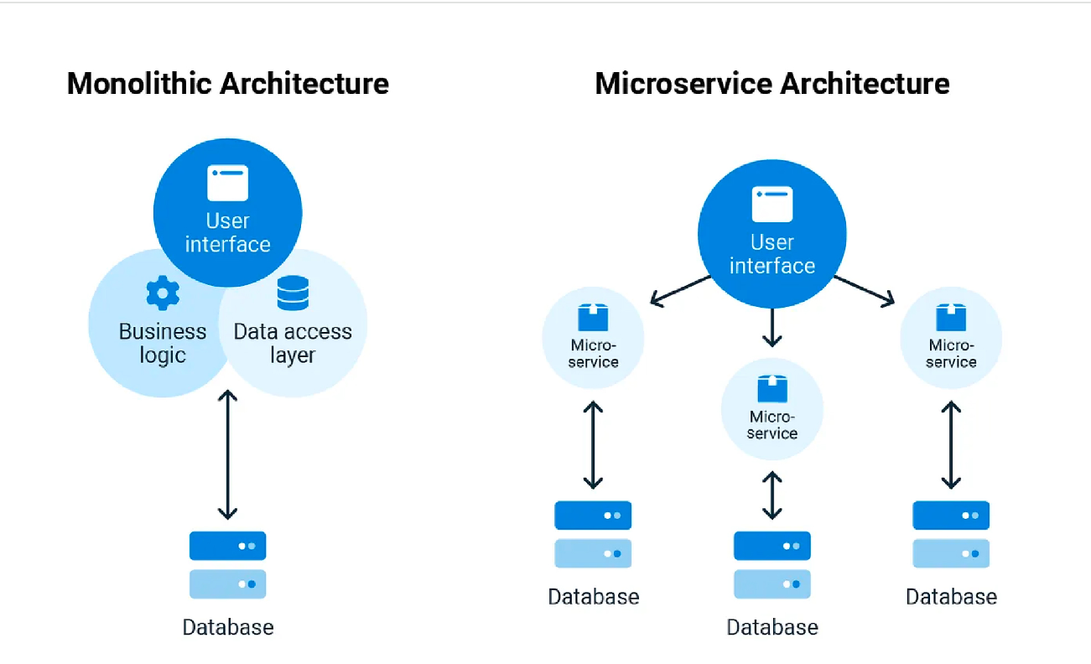

Slide 9
Benefits of Microservices
Scalability: Services can be scaled independently based on demand.
Resilience: Failure in one service does not necessarily impact the entire system.
Faster Time-to-Market: Teams can work on different services simultaneously, speeding up the development process.
Flexibility: Easier to integrate new technologies as the system evolves.
Microservices architecture enables organizations to build and deploy complex, scalable applications by breaking them down into manageable, loosely-coupled services.

Slide 10
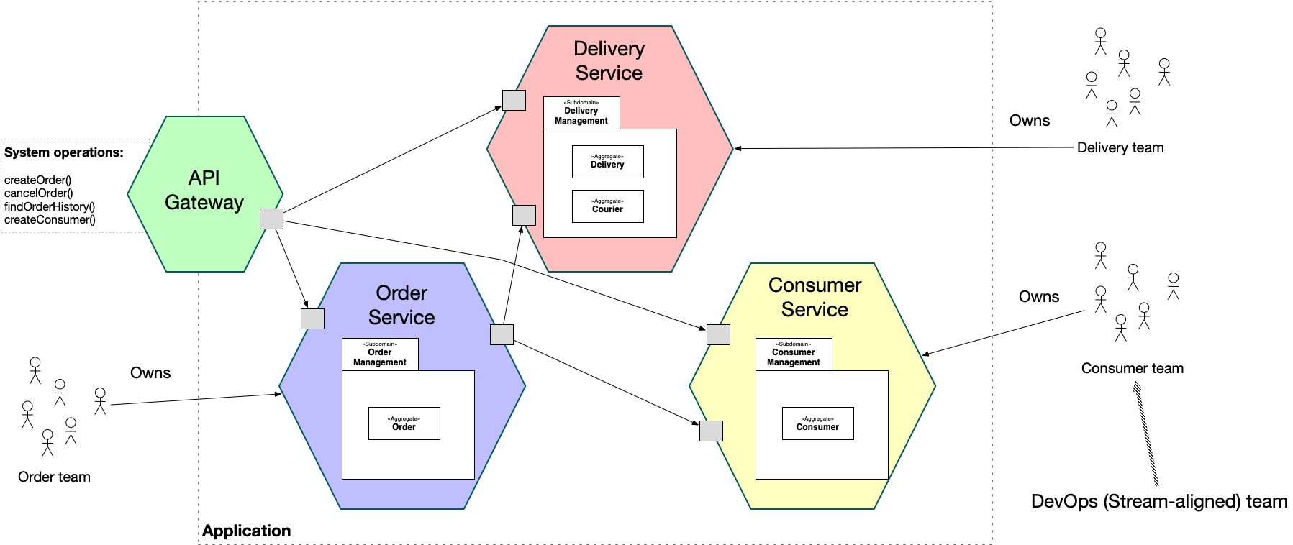
Architecture Patterns
An architecture that structures the application as a set of independently deployable, loosely coupled, components, a.k.a. services. Each service consists of one or more subdomains and is owned by the team (or teams) that owns the subdomains.

Slide 11
Service Discovery
A microservices-based application typically runs in virtualized or containerized environments. The number of instances of a service and its locations changes dynamically. We need to know where these instances are and their names to allow requests to arrive at the target microservice. This is where tactics such as Service Discovery come into play.
The Service Discovery mechanism helps us know where each instance is located. In this way, a Service Discovery component acts as a registry in which the addresses of all instances are tracked.

Slide 12
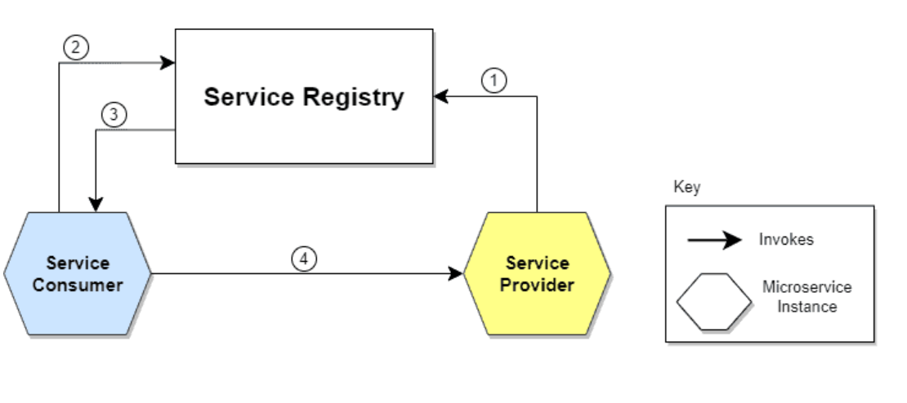
Let’s understand the steps illustrated in the diagram:
The location of the Service Provider is sent to the Service Registry (a database containing the locations of all available service instances).
The Service Consumer asks the Service Discovery Server for the location of the Service Provider.
The location of the Service Provider is searched by the Service Registry in its internal database and returned to the Service Consumer.
The Service Consumer can now make direct requests to the Service Provider.

Slide 13
API Gateway
An API gateway is a entry point for API calls that represent client requests to target applications and services.
An API gateway accepts API requests from a client, processes them based on defined policies, directs them to the appropriate services, and combines the responses for a simplified user experience.
Typically, it handles a request by invoking multiple microservices and aggregating the results. It can also translate between protocols in legacy deployments.

Slide 14
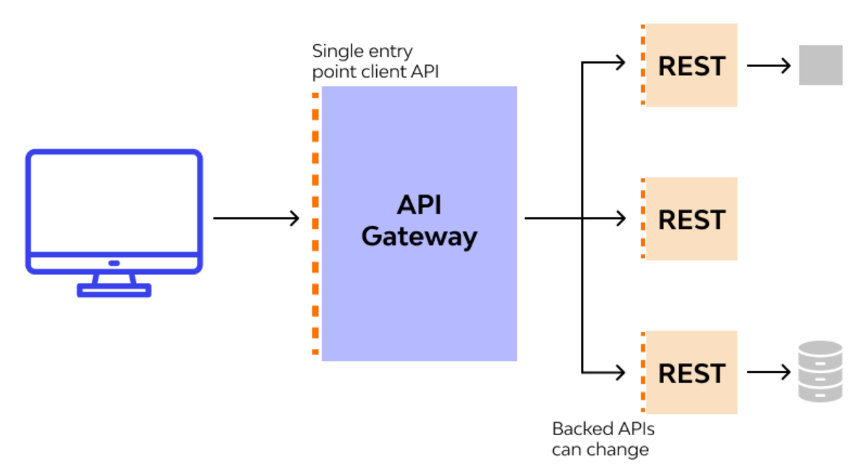

Slide 15
Circuit Breaker Pattern
The Circuit Breaker pattern in microservices acts as a safeguard against service failures by monitoring interactions, setting thresholds, and temporarily halting/Stoping traffic to failing services.
The Circuit Breaker pattern act as a fault-tolerance mechanism that monitors and controls interactions between services. It dynamically manages service availability by temporarily interrupting requests to failing services, preventing system overload, and ensuring graceful degradation in distributed environments.

Slide 16
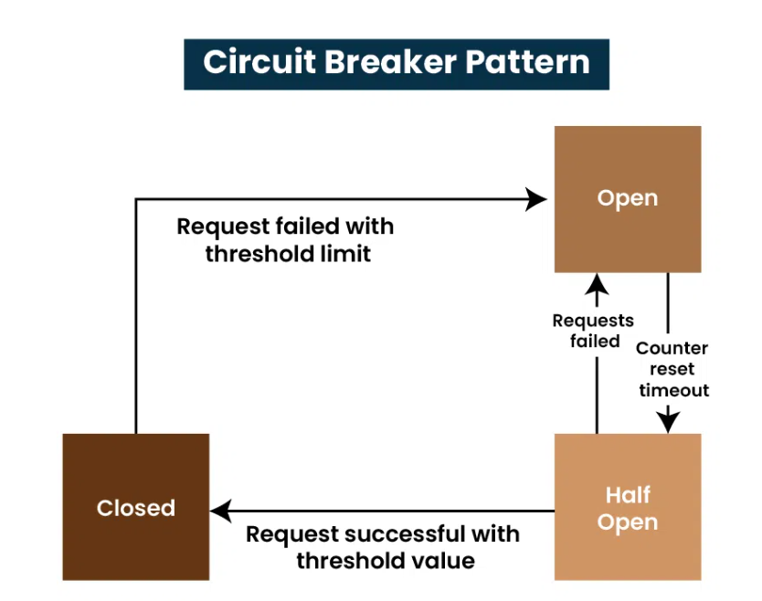

Slide 17
Circuit Breaker Pattern - Characteristics
Fault Tolerance: Enhances fault tolerance by isolating and managing failures in individual services.
Monitoring: Continuously monitors interactions between services to detect issues in real time.
Failure Isolation: Temporarily stops requests to failing services, preventing cascading failures and minimizing disruptions.
Fallback Mechanism: Provides fallback responses or error messages to clients during service failures, ensuring graceful degradation.
Automatic Recovery: Automatically transitions back to normal operation when the failing service recovers, improving system reliability

Slide 18
Saga Architecture Pattern
The Saga architecture pattern provides transaction management using a sequence of local transactions.
A local transaction is the unit of work performed by a Saga participant. Every operation that is part of the Saga can be rolled back by a compensating transaction. Further, the Saga pattern guarantees that either all operations complete successfully or the corresponding compensation transactions are run to undo the work previously completed.
In the Saga pattern, a compensating transaction must be idempotent and retryable. These two principles ensure that we can manage transactions without any manual intervention

Slide 19
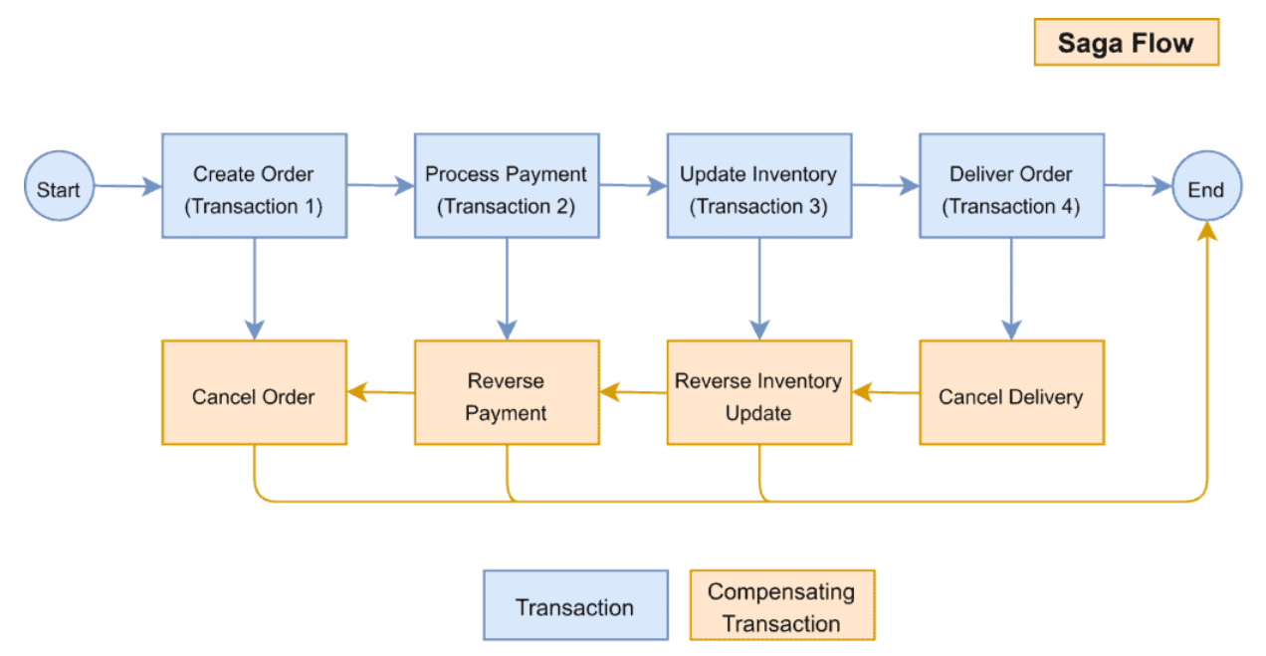

Slide 20
Docker Overview
Docker is an open platform for developing, shipping, and running applications. Docker enables you to separate your applications from your infrastructure so you can deliver software quickly. With Docker, you can manage your infrastructure in the same ways you manage your applications.
Docker provides the ability to package and run an application in a loosely isolated environment called a container. The isolation and security lets you run many containers simultaneously on a given host.
Docker streamlines the development lifecycle by allowing developers to work in standardized environments using local containers which provide your applications and services. Containers are great for continuous integration and continuous delivery (CI/CD) workflows.

Slide 21
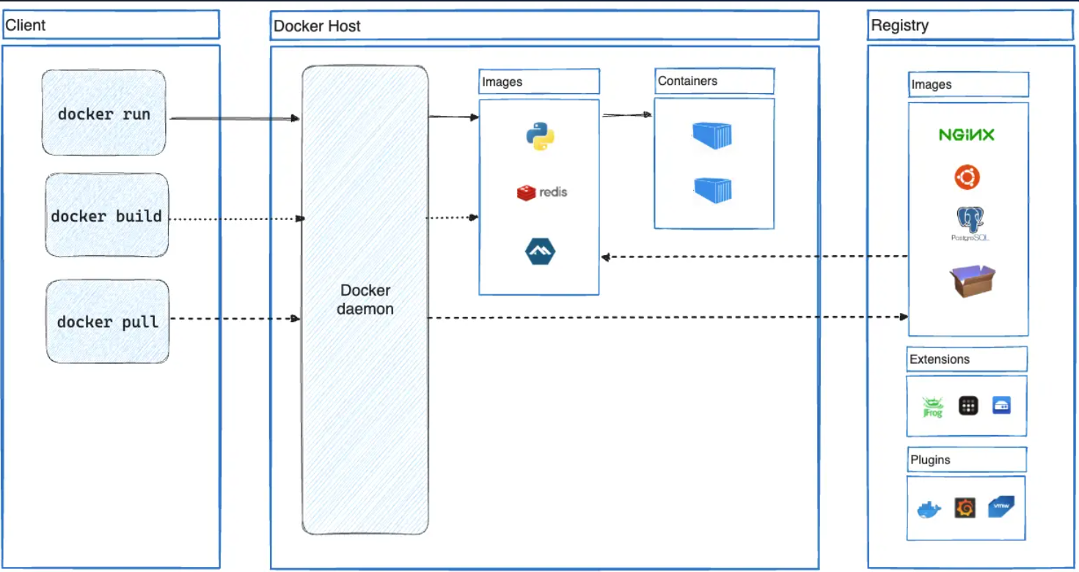
Docker Architecture
Docker uses a client-server architecture.
The Docker client talks to the Docker daemon, which does the heavy lifting of building, running, and distributing your Docker containers.
The Docker client and daemon can run on the same system, or you can connect a Docker client to a remote Docker daemon.

Slide 22
Container Orchestration
Container orchestration is the automation of much of the operational effort required to run containerized workloads and services. This includes a wide range of things software teams need to manage a container’s lifecycle, including provisioning, deployment, scaling (up and down), networking, load balancing and more.
Why do we need container orchestration?
Running containers in production, especially in a microservices architecture, can quickly become challenging. A large-scale system may require managing hundreds or thousands of containers, making the task complex due to their lightweight and ephemeral nature.

Slide 23
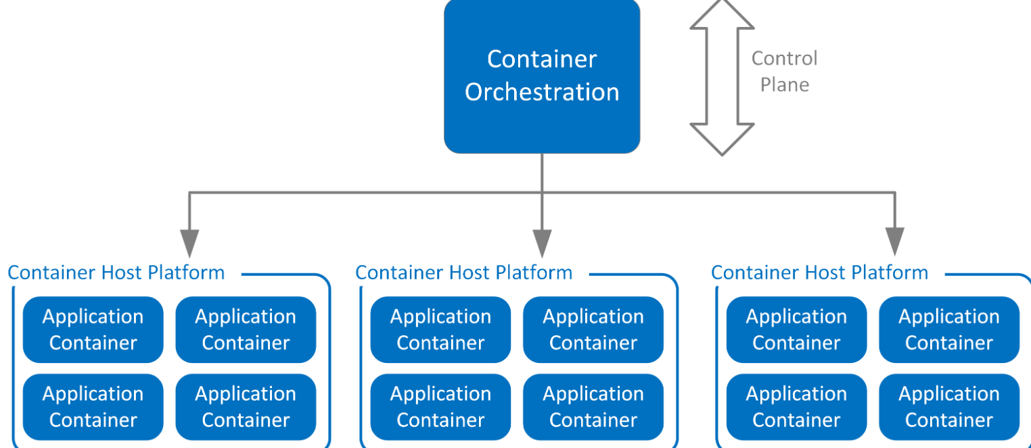

Slide 24
Kubernetes Overview
Kubernetes, also known as K8s, is an open-source system for automating deployment, scaling, and management of containerized applications.
It can automatically scale your containerized applications based on demand, ensuring optimal resource utilization.
Kubernetes manages service discovery, providing internal and external load balancing to distribute traffic evenly across containers.
Kubernetes can automatically restart failed containers, replace containers, and reschedule them when nodes die, ensuring the application stays up and running.
You define the desired state of your application, and Kubernetes ensures that the current state matches the desired state.

Slide 25
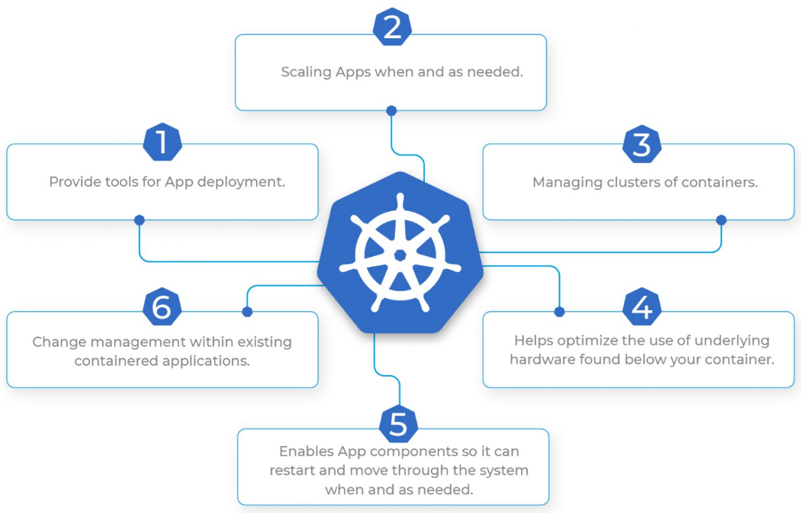
What does Kubernetes do?

Slide 26
What is REST?
REST, which stands for Representational State Transfer, is the most popular architectural style for building APIs.
In a RESTful architecture, resources are identified by URIs (Uniform Resource Identifiers), and operations are performed on those resources using a standard set of HTTP methods.
Resources are represented in JSON or XML, which is transferred between the client and server in the HTTP request and response bodies.

Slide 27
What is gRPC?
gRPC is an open source, high-performance framework that facilitates efficient communication in distributed systems.
gRPC is an implementation of the RPC (Remote Procedure Call) protocol, which enables services to call functions on other machines as if they were local software methods.
gRPC was developed by Google in 2015, and it includes several features that enhance the way remote procedure calls are made.

Slide 28
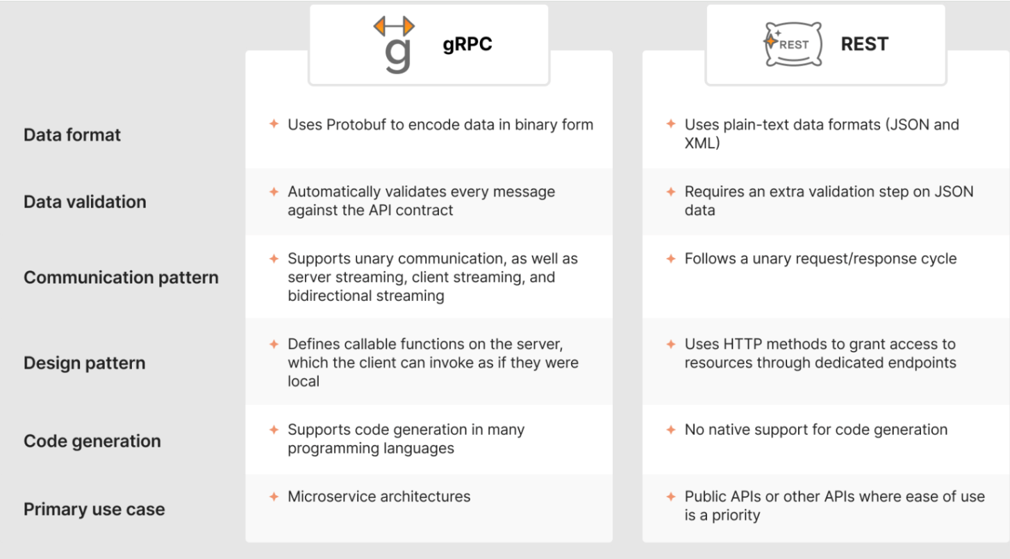
Key differences: gRPC vs REST

Slide 29
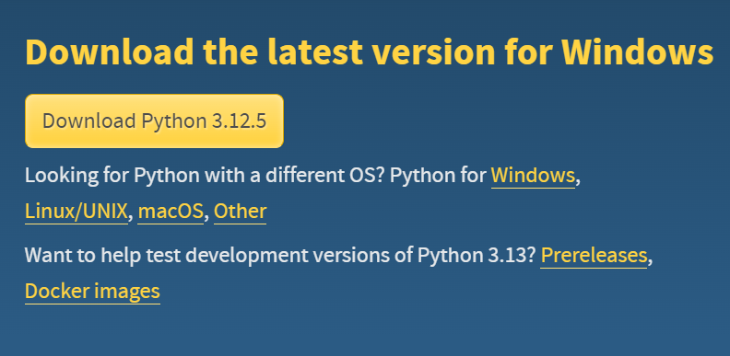
Python - Setting Up the Environment
Python is a versatile, high-level programming language that emphasizes code readability and efficiency, Python enables developers to express complex ideas in fewer lines of code.
It supports rapid development and seamless integration across various systems.
To download python setup, go to https://www.python.org/downloads/.
Find the

Slide 30
Installation
Steps to be followed and remembered:
Step 1: Select Version of Python to Install.
Step 2: Download Python Executable Installer.
Step 3: Run Executable Installer.
Step 4: Verify Python Was Installed On Windows.
Step 5: Verify Pip Was Installed.
Step 6: Add Python Path to Environment Variables.

Slide 31
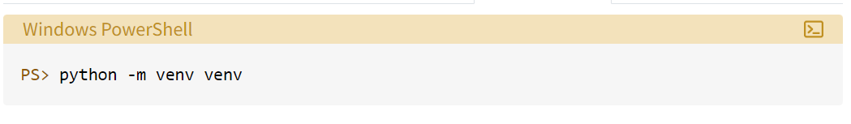
Python virtual environments
The venv module supports creating lightweight “virtual environments”, each with their own independent set of Python packages installed in their site directories.
A virtual environment is created on top of an existing Python installation, known as the virtual environment’s “base” Python, and may optionally be isolated from the packages in the base environment, so only those explicitly installed in the virtual environment are available.
Create It
Any time you’re working on a Python project that uses external dependencies that you’re installing with pip, it’s best to first create a virtual environment

Slide 32
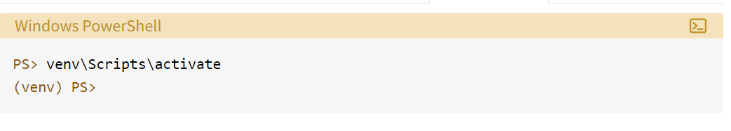
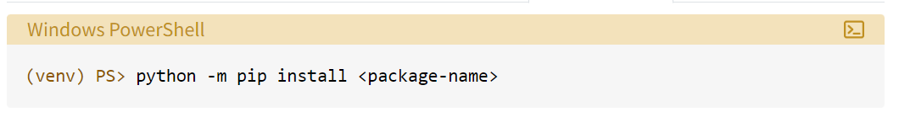
Activate It Now your project has its own virtual environment. Generally, before you start using it, you’ll first activate the environment by executing a script that comes with the installation:
Install Packages Into It

Slide 33
Virtual Environment using Pipenv
Pipenv is a new and popular way of automatically creating a 'virtualenv' for the project.
It creates a Pipfile, which helps to manage the package and can be installed or removed easily.
Through Pipenv, 'pip' and 'virtualenv' can be used together to create a Virtual Environment, Pipfile works as the replacement of the 'requirement.txt.' which tracks the package version according to the given project.
Windows users can use the following command to install 'pipenv'.
pip install pipenv
Linux/Mac Users can use the following command to install 'pipenv' after installing Linux Brew.
brew install pipenv

Slide 34
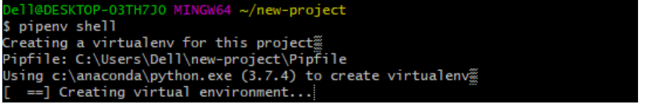
Creating a virtualenv for the project
For creating the 'virtualenv' for the project, use the following command.
pipenv shell The command 'pipenv' creates a new 'virtualenv' for the project along with Pipfile side by side.

Slide 35
What is Docker?
Docker is a set of Platforms as a service (PaaS) products that use Operating system-level virtualization to deliver software in packages called containers.
Containers are isolated from one another and bundle their own software, libraries, and configuration files; they can communicate with each other through well-defined channels.
All containers are run by a single operating system kernel and therefore use fewer resources than a virtual machine.
You can run the docker image as a docker container in any machine where docker is installed without depending on the operating system.

Slide 36
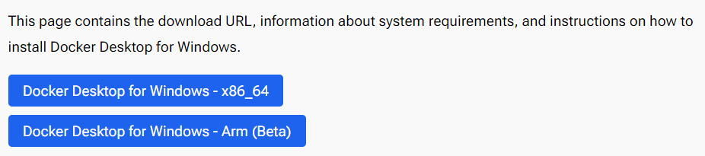
Install Docker Engine
Docker Engine is also available for Windows, macOS, and Linux, through Docker Desktop.
For Windows:- https://docs.docker.com/desktop/install/windows-install/

Slide 37
Install interactively
Download the installer using the download button at the top of the page, or from the release notes.
Double-click Docker Desktop Installer.exe to run the installer. By default, Docker Desktop is installed at C:\Program Files\Docker\Docker.
When prompted, ensure the Use WSL 2 instead of Hyper-V option on the Configuration page is selected or not depending on your choice of backend.
Follow the instructions on the installation wizard to authorize the installer and proceed with the install.
When the installation is successful, select Close to complete the installation process.
Start Docker Desktop.

Slide 38
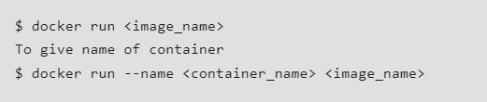

Docker Commands
Docker Run command
This command is used to run a container from an image. The docker run command is a combination of the docker create and docker start commands. It creates a new container from the image specified and starts that container.
Docker Pull
This command allows you to pull any image which is present in the official registry of docker, Docker hub. By default, it pulls the latest image, but you can also mention the version of the image.

Slide 39

Docker PS
This command (by default) shows us a list of all the running containers. We can use various flags with it.
-a flag: shows us all the containers, stopped or running.
-l flag: shows us the latest container.
-q flag: shows only the Id of the containers.

Slide 40
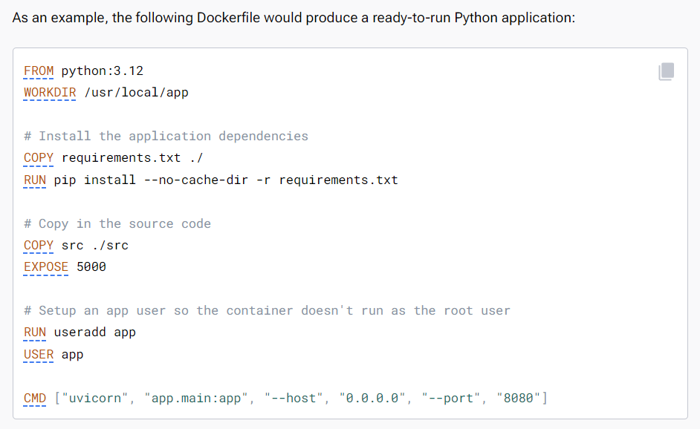
Writing Docker Files
A Dockerfile is a text-based document that's used to create a container image. It provides instructions to the image builder on the commands to run, files to copy, startup command, and more.

Slide 41
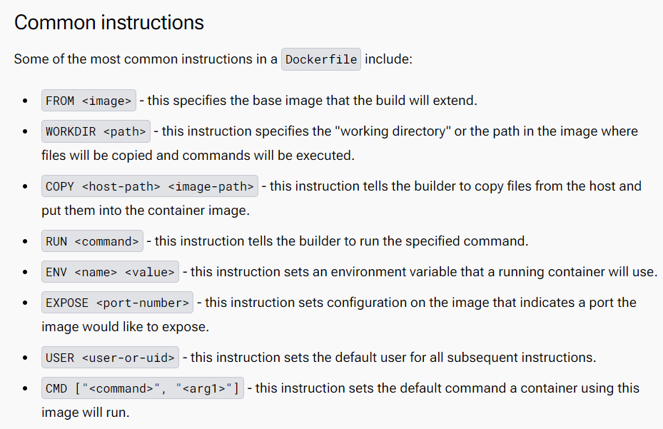

Slide 42
Creating Project Repo
Create your first repository
To create a repository:
Sign in to Docker Hub (https://hub.docker.com)
On the Repositories page, select Create repository.
Name it <your-username>/my-private-repo.
Set the visibility to Private.
Select Create.

Slide 43
Structuring the repository
All Docker-related files are organized in a .docker directory at the same level as the main application.
Each service has its own subdirectory within this directory for configuration.
A .shared folder contains scripts and configurations required by multiple services.
Include a .env.example file for environment variables used in the docker-compose.yml, along with a docker-test.sh script for high-level validation of the Docker containers.
Additionally, a Makefile with common Docker commands is placed in the repository root for easy control.

Slide 44
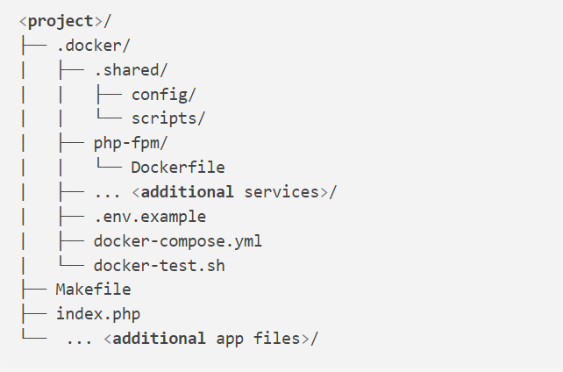

Slide 45
Creating a Basic Flask Application
Flask is a small and lightweight Python web framework that provides useful tools and features that make creating web applications in Python easier.
Step 1 — Installing Flask
In this step, you’ll activate your Python environment and install Flask using the pip package installer.
If you haven’t already activated your programming environment, make sure you’re in your project directory
$ source env/bin/activate

Slide 46
Now you’ll install Python packages and isolate your project code away from the main Python system installation. You’ll do this using pip and python.
To install Flask, run the following command:
Once the installation is complete, run the following command to confirm the installation:
pip install flask
python -c "import flask; print(flask.__version__)"

Slide 47
Creating a Base Application
Now that you have your programming environment set up, you’ll start using Flask. In this step, you’ll make a small web application inside a Python file and run it to start the server, which will display some information on the browser.
Create a file hello.py
Open and write below code.
from flask import Flask
app = Flask(__name__)
@app.route('/')
def hello():
return 'Hello, World!'

Slide 48
Save and close the file.
To run your web application, you’ll first tell Flask where to find the application (the hello.py file in your case) with the FLASK_APP environment variable:
Then run it in development mode with the FLASK_ENV environment variable:
Lastly, run the application using the flask run command:
export FLASK_APP=hello
export FLASK_ENV=development
flask run

Slide 49
Once the application is running the output will be something like this:
Open a browser and type in the URL http://127.0.0.1:5000/, you will receive the string Hello, World! as a response, this confirms that your application is successfully running.
Output
* Serving Flask app "hello" (lazy loading)
* Environment: development
* Debug mode: on
* Running on http://127.0.0.1:5000/ (Press CTRL+C to quit)
* Restarting with stat
* Debugger is active!
* Debugger PIN: 813-894-335

Slide 50
Building API’s with Flask
We’ll start by creating an empty folder for our project, opening it in our text editor and adding a app.py file.
Now run it.
Your application should now be running on port 5000.
from flask import Flask
app = Flask(__name__)
@app.route('/')
def hello():
return '<h1>Hello, World!</h1>'
if __name__ == '__main__':
app.run(debug=True)

Slide 51
Adding Flask RESTful
We’ll start by first installing FlaskRESTful, then modifying our routes to return some JSON data.
In main.py import Resource & API from flask_restful, then create an instance of the Api class.
We will update our routes to use class base views now and inherit from Resource. These class based views will help us make our API more restful by separating our logic by the type of http method. For now each view will only process “get” requests
pip install flask-restful

Slide 52
from flask import Flask
from flask_restful import Resource, Api
app = Flask(__name__)
api = Api(app)
fakeDatabase = {
1:{'name':'Clean car'},
2:{'name':'Write blog'},
3:{'name':'Start stream'},
}
class Items(Resource):
def get(self):
return fakeDatabase
class Item(Resource):
def get(self, pk):
return fakeDatabase[pk]
api.add_resource(Items, '/')
api.add_resource(Item, '/<int:pk>')
if __name__ == '__main__':
app.run(debug=True)

Slide 53
#POST
from flask import Flask, request
class Items(Resource):
def get(self):
return fakeDatabase
def post(self):
data = request.json
itemId = len(fakeDatabase.keys()) + 1
fakeDatabase[itemId] = {'name':data['name']}
return fakeDatabase
#PUT
class Item(Resource):
def get(self, pk):
return fakeDatabase[pk]
def put(self, pk):
data = request.json
fakeDatabase[pk]['name'] = data['name']
return fakeDatabase

Slide 54
#Delete
class Item(Resource):
def get(self, pk):
return fakeDatabase[pk]
def put(self, pk):
data = request.json
fakeDatabase[pk]['name'] = data['name']
return fakeDatabase
def delete(self, pk):
del fakeDatabase[pk]
return fakeDatabase

Slide 55
Database Configuration
Time to move on from our place holder database and configure something more practical. For this we will use SQLite.
We will be using SQLAlchemy as our ORM so lets start by importing that first:
Now in our main.py file:
pip install flask-sqlalchemy
from flask_sqlalchemy import SQLAlchemy
......
app.config['SQLALCHEMY_DATABASE_URI'] = 'sqlite:///todo.db'
db = SQLAlchemy(app)

Slide 56
Modeling our data
Still in our main.py file lets create a class that inherits from db.model.
Once you have this model. Lets go to our terminal and actual create this database.
class Task(db.Model):
id = db.Column(db.Integer, primary_key=True)
name = db.Column(db.String(200), nullable=False)
def __repr__(self):
return self.name
(env) C:\Users\Dennis Ivy\Desktop\FlaskApp> python
>>> from app import db
>>> db.create_all()
>>> exit()

Slide 57
Working with the database
Now that we have our database, its time to learn how to add, modify and query data.
Let start with making a request to get all the items in the database.
#Querying items in a table
class Items(Resource):
def get(self):
tasks = Task.query.all()
return tasks
...
class Item(Resource):
def get(self, pk):
task = Task.query.filter_by(id=pk).first()
return task
...

Slide 58
If we have now data in our database yet we should see an empty array return from this request. We are about to face an issue when we add some data so lets give that a test.
#Adding dataclass Items(Resource):
def get(self):
tasks = Task.query.all()
return tasks
def post(self):
data = request.json
task = Task(name=data['name'])
db.session.add(task)
db.session.commit()
tasks = Task.query.all()
# itemId = len(fakeDatabase.keys()) + 1
# fakeDatabase[itemId] = {'name':data['name']}
return tasks

Slide 59
CRUD
Modifying data
class Item(Resource):
...
@marshal_with(taskFields)
def put(self, pk):
data = request.json
task = Task.query.filter_by(id=pk).first()
task.name = data['name']
db.session.commit()
return task
...

Slide 60
Deleting data
class Item(Resource):
...
@marshal_with(taskFields)
def delete(self, pk):
task = Task.query.filter_by(id=pk).first()
db.session.delete(task)
db.session.commit()
tasks = Task.query.all()
return tasks

Slide 61
Database migrations with Flask-Migrate
Flask-Migrate is a Flask extension based on the Alembic library, allowing you to manage database migrations.
Database migration is transferring data between different database schemas without any data loss. It’s commonly used to upgrade a database, change its schema by adding new table columns or relationships, and ensure a smooth transition with minimal downtime and no data loss.
For example, if you have a table called Product with a list of product names and want to add a price column to this table, you can use database migration to add the price column without losing the existing product data.

Slide 62
Dockerizing the Flask Application
With Docker, you can now easily ship, test, and deploy your code quickly while maintaining full control over your infrastructure. It significantly reduces how long it takes to get from writing code to running it in production.
After completing the following steps, our application directory structure will look like this:
flask-docker
├── app.py
├── Dockerfile
├── requirements.txt
└── venv

Slide 63
Let's add the following lines of code to our app.py:
from flask import Flask
app = Flask(__name__)
@app.route('/')
def hello_geek():
return '<h1>Hello from Flask & Docker</h2>'
if __name__ == "__main__":
app.run(debug=True)

Slide 64
Now, if we run python app.py on the command line to test our Flask app, we should get results similar to the ones shown below:
Serving Flask app 'app' (lazy loading)
* Environment: production
WARNING: This is a development server. Do not use it in a production deployment.
Use a production WSGI server instead.
* Debug mode: on
* Running on http://127.0.0.1:5000/ (Press CTRL+C to quit)
* Restarting with stat
* Debugger is active!
* Debugger PIN: 316-584-348

Slide 65
How to modify the Dockerfile
# syntax=docker/dockerfile:1
FROM python:3.8-slim-buster
WORKDIR /python-docker
COPY requirements.txt requirements.txt
RUN pip3 install -r requirements.txt
COPY . .
CMD [ "python3", "-m" , "flask", "run", "--host=0.0.0.0"]

Slide 66
How to Build a Docker Image
After that, all that remains is to build our image. Using docker build, we can now enlist Docker's help in building the image. You can combine the build command with other tags, such as the "--tag" flag, to specify the image name.
docker build --tag python-docker .

Slide 67
How to run an image as a container
Common options:
-d: Run the container in detached mode (in the background).
-p <host-port>:<container-port>: Map a host port to a container port.
--name <container-name>: Assign a custom name to the container.
-v <host-path>:<container-path>: Mount a host directory as a data volume in the container.
docker run <options> <image-name>

Slide 68
Docker Compose overview
Docker Compose is a tool for defining and running multi-container applications. It is the key to unlocking a streamlined and efficient development and deployment experience.
Compose simplifies the control of your entire application stack, making it easy to manage services, networks, and volumes in a single, comprehensible YAML configuration file. Then, with a single command, you create and start all the services from your configuration file.
Compose works in all environments; production, staging, development, testing, as well as CI workflows. It also has commands for managing the whole lifecycle of your application:
Start, stop, and rebuild services
View the status of running services
Stream the log output of running services
Run a one-off command on a service

Slide 69
Install Docker Compose
To install and use Docker Compose, Docker Daemon and Docker Client should be running on your Windows server. Before getting started it’s best to ensure that the Docker service is running error-free.
Step 1: Start PowerShell
Set up TLS security protocol
Step 3: Download and install Docker Compose
[Net.ServicePointManager]::SecurityProtocol = [Net.SecurityProtocolType]::Tls12
Start-BitsTransfer -Source "https://github.com/docker/compose/releases/download/v2.17.2/docker-compose-Windows-x86_64.exe" -Destination $Env:ProgramFiles\Docker\docker-compose.exe

Slide 70
Step 4: Test Docker Compose
Check if the installation was successful by displaying the current version of Compose:
When you see the version number of Compose, the installation was successful.
docker compose version

Slide 71
Defining services
The structure of a docker-compose.yml file typically follows a hierarchical format using YAML syntax.
Version: This is the version of the Docker Compose file format you’re using. It’s typically at the top of the file and specifies which features and syntax are available for use.
For example:
Services: This section defines the various services or containers that make up your application. Each service is listed under the services keyword and has its own configuration.
version: '3.8'

Slide 72
Create the Compose file
Here's an example of services:
services:
web:
image: nginx:latest
ports:
- "8080:80"
database:
image: postgres:latest
environment:
POSTGRES_USER: myuser
POSTGRES_PASSWORD: mypassword

Slide 73
Networks: This section allows you to define custom networks for your services. Networks enable containers to communicate with each other over isolated networks. You can specify network configurations such as aliases, IP addresses, and external connectivity.
Volumes: The volumes section allows you to define volumes for persisting data or sharing data between containers. You can specify volume configurations such as source paths, target paths within containers, and read-only settings.
Configs: This section allows you to define configurations for your services using external files. Configurations can include environment variables, file paths, and other settings.
networks:
my_network:
driver: bridge

Slide 74
Managing multi-container applications
Docker Compose defines your entire multi-container application in a single YAML file called compose.yml. This file specifies configurations for all your containers, their dependencies, environment variables, and even volumes and networks.
You don't need to run multiple docker run commands. All you need to do is define your entire multi-container application in a single YAML file. This centralizes configuration and simplifies management.
You can run containers in a specific order and manage network connections easily.
You can simply scale individual services up or down within the multi-container setup. This allows for efficient allocation based on real-time needs.
You can implement persistent volumes with ease.
It's easy to set environment variables once in your Docker Compose file.

Slide 75
Inter-service Communication
Inter-service communication is basically two Microservices communicating using either HTTP protocol or asynchronous message patterns.
There are two types of inter-service communication in Microservices:
Synchronous communication
In synchronous communication, one service will communicate with another service through the rest endpoint using HTTP or https protocol. In this approach, calling service will wait until the caller service responds.
Asynchronous communication
In asynchronous communication, one service will communicate with another service through the asynchronous messaging. The calling service will not wait to respond by the caller service. First, it will return a response to the user, then the remaining services will process the request.

Slide 76
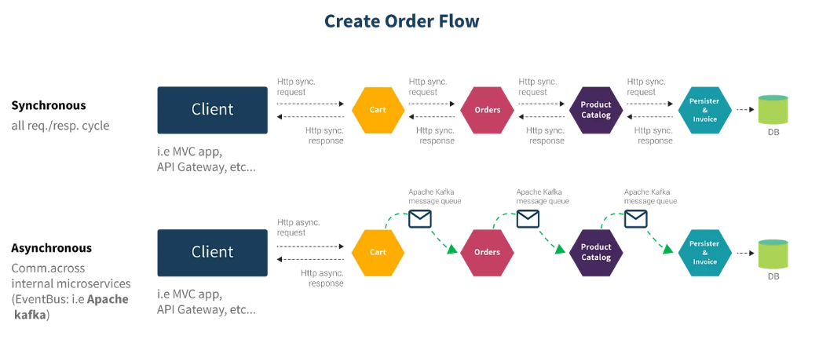

Slide 77
REST vs gRPC

Slide 78
Implementing gRPC in Python
Setting Up the Environment
Install gRPC and Protocol Buffers:
pip install grpcio grpcio-tools

Slide 79
Defining the Service:
Create a .proto file that defines the service and messages:
syntax = "proto3";
service MyService {
rpc MyFunction(MyRequest) returns (MyResponse);}
message MyRequest {
string name = 1;}
message MyResponse {
string message = 1;}

Slide 80
Generating Python Code from .proto:
Compile the .proto file to generate Python code:
python -m grpc_tools.protoc -I. --python_out=. --grpc_python_out=. my_service.proto

Slide 81
Implementing the Server:
Import generated files and implement the server logic:
from concurrent import futures
import grpc
import my_service_pb2
import my_service_pb2_grpc
class MyServiceServicer(my_service_pb2_grpc.MyServiceServicer):
def MyFunction(self, request, context):
return my_service_pb2.MyResponse(message=f'Hello, {request.name}!')
def serve():
server = grpc.server(futures.ThreadPoolExecutor(max_workers=10))
my_service_pb2_grpc.add_MyServiceServicer_to_server(MyServiceServicer(), server)
server.add_insecure_port('[::]:50051')
server.start()
server.wait_for_termination()
if __name__ == '__main__':
serve()

Slide 82
Implementing the Client:
Create a client to interact with the gRPC server
import grpc
import my_service_pb2
import my_service_pb2_grpc
def run():
with grpc.insecure_channel('localhost:50051') as channel:
stub = my_service_pb2_grpc.MyServiceStub(channel)
response = stub.MyFunction(my_service_pb2.MyRequest(name='World'))
print(f'Client received: {response.message}')
if __name__ == '__main__':
run()

Slide 83
Running the Application:Start the server and run the client to test the gRPC service.
Benefits of gRPC:High performance and efficiency.
Strongly typed, contract-first API design.
Supports multiple programming languages.
Bi-directional streaming and integrated load balancing.

Slide 84
Introduction to RabbitMQ and Kafka
Kafka is an open-source distributed event streaming platform, facilitating raw throughput. Written in Java and Scala, Kafka is a pub/sub message bus geared towards streams and high-ingress data replay. Rather than relying on a message queue, Kafka appends messages to the log and leaves them there, where they remain until the consumer reads it or reaches its retention limit.
RabbitMQ is an open-source distributed message broker that facilitates efficient message delivery in complex routing scenarios. It’s called “distributed” because RabbitMQ typically runs as a cluster of nodes where the queues are distributed across the nodes — replicated for high availability and fault tolerance.

Slide 85
Introduction to Kubernetes
Kubernetes is a portable, extensible, open source platform for managing containerized workloads and services, that facilitates both declarative configuration and automation. It has a large, rapidly growing ecosystem. Kubernetes services, support, and tools are widely available.
Containers are a good way to bundle and run your applications. In a production environment, you need to manage the containers that run the applications and ensure that there is no downtime. For example, if a container goes down, another container needs to start. Wouldn't it be easier if this behavior was handled by a system?
That's how Kubernetes comes to the rescue! Kubernetes provides you with a framework to run distributed systems resiliently. It takes care of scaling and failover for your application, provides deployment patterns, and more. For example: Kubernetes can easily manage a canary deployment for your system.

Slide 86
Kubernetes provides you with:
Service discovery and load balancing Kubernetes can expose a container using the DNS name or using their own IP address.
Storage orchestration Kubernetes allows you to automatically mount a storage system of your choice, such as local storages, public cloud providers, and more.
Automated rollouts and rollbacks You can describe the desired state for your deployed containers using Kubernetes, and it can change the actual state to the desired state at a controlled rate.
Self-healing Kubernetes restarts containers that fail, replaces containers, kills containers that don't respond to your user-defined health check, and doesn't advertise them to clients until they are ready to serve.

Slide 87
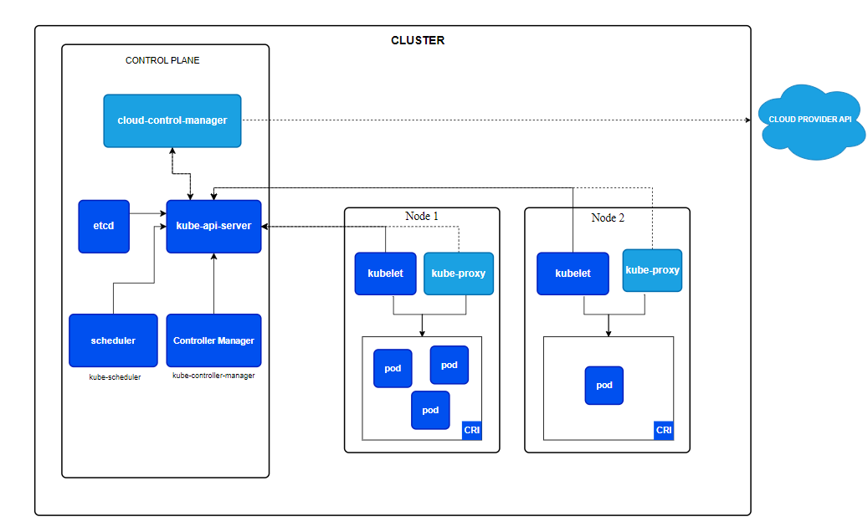
Kubernetes architecture and components

Slide 88
Control plane components
The control plane's components make global decisions about the cluster (for example, scheduling), as well as detecting and responding to cluster events (for example, starting up a new pod when a Deployment's replicas field is unsatisfied).
kube-apiserver:- The API server is a component of the Kubernetes control plane that exposes the Kubernetes API. The API server is the front end for the Kubernetes control plane.
Etcd:- Consistent and highly-available key value store used as Kubernetes' backing store for all cluster data.
kube-scheduler:- Control plane component that watches for newly created Pods with no assigned node and selects a node for them to run on.

Slide 89
kube-controller-manager:- Control plane component that runs controller processes. Logically, each controller is a separate process, but to reduce complexity, they are all compiled into a single binary and run in a single process.
Node components
Kubelet:- An agent that runs on each node in the cluster. It makes sure that containers are running in a Pod.
Container runtime:- A fundamental component that empowers Kubernetes to run containers effectively. It is responsible for managing the execution and lifecycle of containers within the Kubernetes environment.
kube-proxy:- kube-proxy is a network proxy that runs on each node in your cluster, implementing part of the Kubernetes Service concept.

Slide 90
Create a Kubernetes Cluster (Minikube)
Step 1 - Cluster up and running
If you haven’t already, first install minikube. Check that it is properly installed, by running the minikube version command:
Once minikube is installed, start the cluster, by running the minikube start command:
Great! You now have a runnning Kubernetes cluster in your terminal. minikube started a virtual environment for you, and a Kubernetes cluster is now running in that environment
minikube version
minikube start

Slide 91
Step 2 - Cluster version
To check if kubectl is installed you can run the kubectl version command:
Step 3 - Cluster details
Let’s view the cluster details. We’ll do that by running kubectl cluster-info:
To view the nodes in the cluster, run the kubectl get nodes command:
kubectl version
kubectl cluster-info
kubectl get nodes

Slide 92
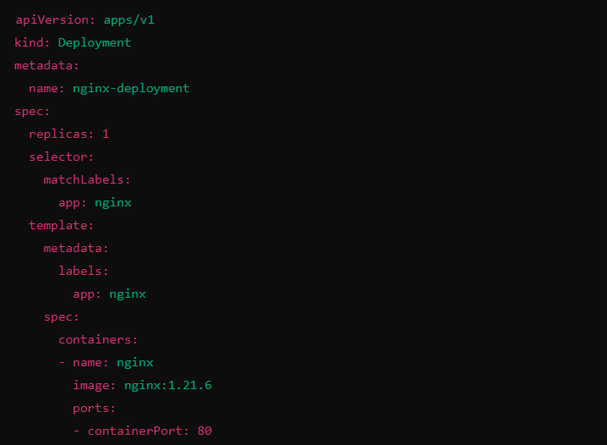
Writing Kubernetes manifests
Writing Kubernetes manifest files involves defining resources such as Pods, Deployments, Services, ConfigMaps, and Secrets using YAML or JSON.
Deployment Manifest: A Deployment is used to manage a set of identical pods and ensure that a specified number of them are always running.
Example deployment.yaml:

Slide 93
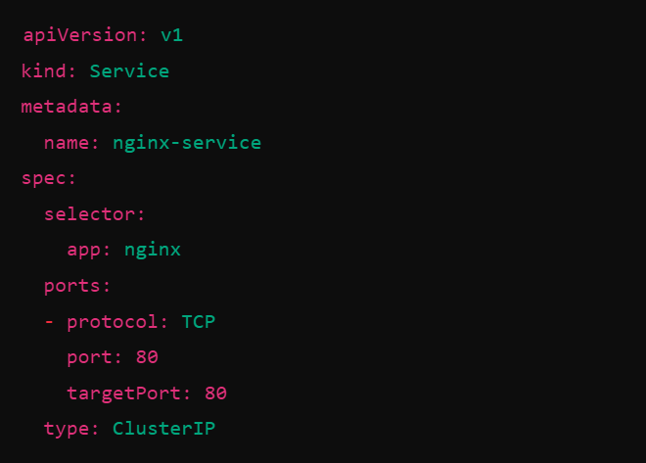
Service Manifest

Slide 94
Deploying Microservices on Kubernetes
Step 1: Containerize Your Microservices
Create Docker file
Build Docker Images
Push Docker Images to a Container Registry.
Step 2: Create Kubernetes Manifests
Deployment Manifest: Define a Deployment resource to manage the pods for each microservice. Deployment.yaml
Service Manifest: Define a Service resource to expose your microservice within the Kubernetes cluster or to external traffic. Service.yaml

Slide 95
Step 3: Deploy Microservices to Kubernetes
Apply Manifests: Use kubectl to apply the deployment and service manifests.
Verify Deployment: Check the status of your deployment:
kubectl apply -f deployment.yaml
kubectl apply -f service.yaml
kubectl get deployments
kubectl get pods
kubectl get services

Slide 96
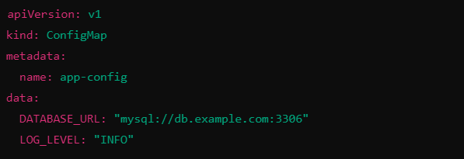
Managing secrets and configurations
Managing secrets and configurations in Kubernetes involves using ConfigMaps and Secrets to handle non-sensitive and sensitive data, respectively.
These resources allow you to decouple configuration artifacts from image content to keep your applications portable and secure.
1. Using ConfigMaps
ConfigMaps are used to store non-sensitive configuration data in key-value pairs. They can be used by pods to configure the applications they run.

Slide 97
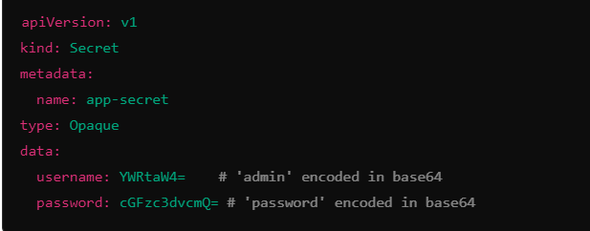
2. Using Secrets
Secrets are used to store sensitive information, such as passwords, OAuth tokens, and SSH keys. Like ConfigMaps, they can be used by pods to configure the applications they run but with enhanced security.

Slide 98
Setting up Prometheus and Grafana
Prometheus is an open-source monitoring system for which Grafana provides out-of-the-box support. This topic walks you through the steps to create a series of dashboards in Grafana to display system metrics for a server monitored by Prometheus.
Setup Grafana and Prometheus:
Download Prometheus and node_exporter
Install Prometheus node_exporter
Install and configure Prometheus
Configure Prometheus for Grafana
Check Prometheus metrics in Grafana Explore view
Start building dashboards

Slide 99
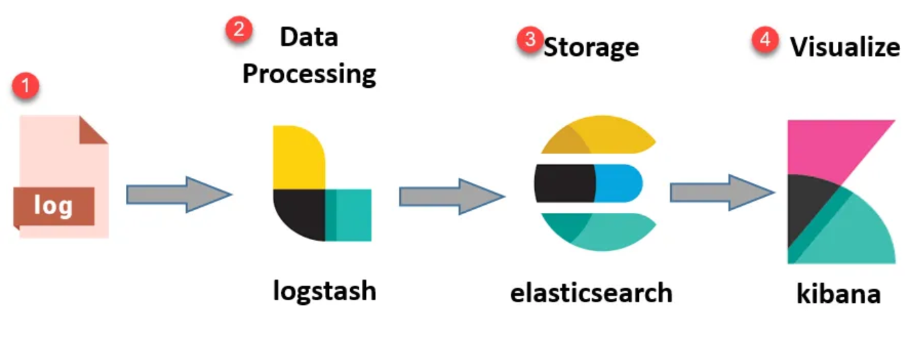
Centralized logging with ELK stack
ELK provides centralized logging that be useful when attempting to identify problems with servers or applications. It allows you to search all your logs in a single place. It also helps to find issues that occur in multiple servers by connecting their logs during a specific time frame.

Slide 100
Securing Microservices
The security of microservices is a critical consideration due to the distributed nature of these services and their increased surface area for potential attacks.
Each microservice operates independently, often with its own data store and communication protocols, which can complicate security management.
Security of micro-services mainly focuses on designing secure communication between all the services which are implemented by the application.
Password Complexity
Authentication Mechanism
Securing Rest Data
Penetration Testing

Slide 101
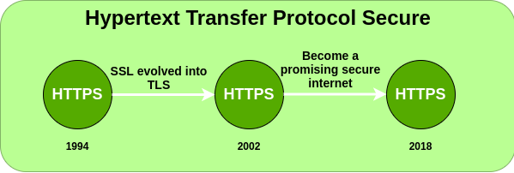
Secure communication (HTTPS, SSL/TLS)
HTTPS stands for Hyper Text Transfer Protocol Secure. HTTP Secure (HTTPS), could be a combination of the Hypertext Transfer Protocol with the SSL/TLS convention to supply encrypted communication and secure distinguishing proof of an arranged web server.
HTTPS is more secure than HTTP because HTTPS is certified by the SSL(Secure Socket Layer). Whatever website you are visiting on the internet, if its URL is HTTP, then that website is not secure.

Slide 102
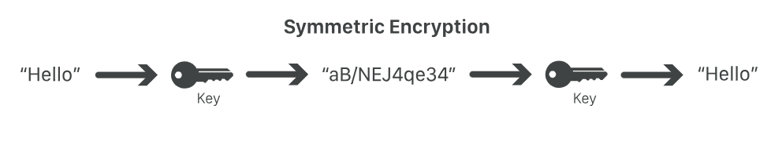
SSL:- SSL stands for Secure Sockets Layer, and it refers to a protocol for encrypting, securing, and authenticating communications that take place on the Internet. Although SSL was replaced by an updated protocol called TLS (Transport Layer Security) some time ago, "SSL" is still a commonly used term for this technology.
TLS handshake:- TLS communication sessions begin with a TLS handshake. A TLS handshake uses something called asymmetric encryption, meaning that two different keys are used on the two ends of the conversation. This is possible because of a technique called public key cryptography.

Slide 103
Rate limiting and throttling
The Rate Limiting policy limits the number of requests an API accepts within a window of time. The API rejects requests that exceed the limit. You can configure multiple limits with window sizes ranging from milliseconds to years.
The Throttling policy queues requests that exceed limits for possible processing in a subsequent window. The API eventually rejects the request if processing cannot occur after a certain number of attempts. You can configure a delay between retries, as well as limit the number of retries.
Rate Limiting and Throttling policies are designed to limit API access but have different intentions: Rate limiting protects an API by applying a hard limit on its access. Throttling shapes API access by smoothing spikes in traffic.

Slide 104
CI/CD pipelines with GitHub Actions
GitHub Actions and GitLab CI/CD are both used to generate pipelines to automate building, testing, and deploying your code. Both share similarities including:
CI/CD functionality has direct access to the code stored in the project repository.
Pipeline configurations written in YAML and stored in the project repository.
Pipelines are configurable and can run in different stages.
Jobs can each use a different container image.

Slide 105
Additionally, there are some important differences between the two:
GitHub has a marketplace for downloading 3rd-party actions, which might require additional support or licenses.
Self-managed GitLab instances support both horizontal and vertical scaling, while GitHub Enterprise Server only supports vertical scaling.
GitLab maintains and supports all features in house, and some 3rd-party integrations are accessible through templates.
GitLab provides a built-in container registry.
GitLab has native Kubernetes deployment support.
GitLab provides granular security policies.

Slide 106
Maintaining backward compatibility
Maintaining backward compatibility in microservices is crucial to ensure that updates to individual services do not break the functionality of other dependent services.
Version APIs: Implement API versioning to support multiple versions concurrently.
Use Feature Toggles: Deploy new features behind feature toggles to ensure controlled rollouts.
Deprecation Strategy: Clearly communicate deprecations with a transition period for consumers.
Contract Testing: Use contract testing to validate that service interactions remain compatible.
Compatibility Layers: Introduce adapters or transitional interfaces to support old and new functionality.
Idempotency: Design APIs to be idempotent to ensure consistent behavior on repeated requests.

Slide 107
Documentation and API versioning
Documentation: Maintain comprehensive documentation for each API version, including detailed endpoint descriptions, request/response formats, examples, error handling, and deprecation notices.
Provide migration guides to help consumers transition smoothly between versions, and keep documentation updated with each release to reflect changes accurately.
API Versioning: Adopt robust versioning strategies, such as URI versioning (/api/v1/resource) or header-based versioning (Accept: application/vnd.myapp.v1+json), to manage breaking changes while supporting multiple versions concurrently.
Ensure versioning is transparent to users, and provide clear guidance on how to access and utilize different versions, facilitating seamless upgrades and minimizing disruption to existing consumers.

